Slide 1
Intro to Machine Learning with Python
Week4

Slide 2
Topics to be covered…..
Goal of this module: learn the general concept of machine learning and its components. Later in the following modules, we will go through the details of the components.
Introduction to Machine Learning
Supervised Learning
Unsupervised Learning
Python libraries for Machine Learning

Slide 3
What is Machine Learning?
The capability of Artificial Intelligence systems to learn by extracting patterns from data is known as Machine Learning.
Machine Learning is an idea to learn from examples and experience, without being explicitly programmed. Instead of writing code, you feed data to the generic algorithm, and it builds logic based on the data given.

Slide 4
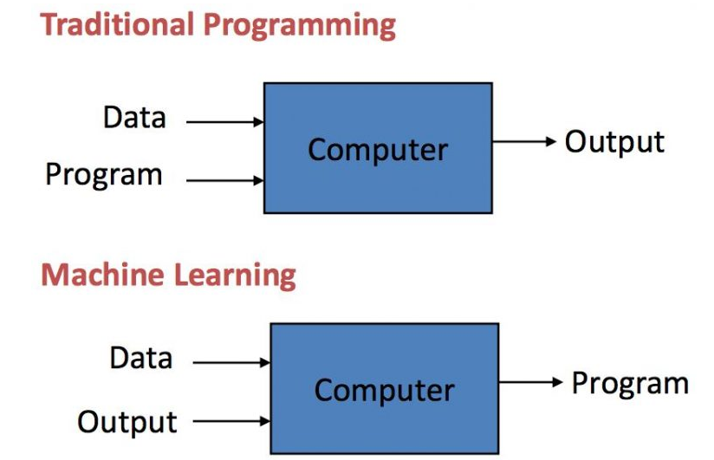
Traditional Programming vs Machine learning

Slide 5
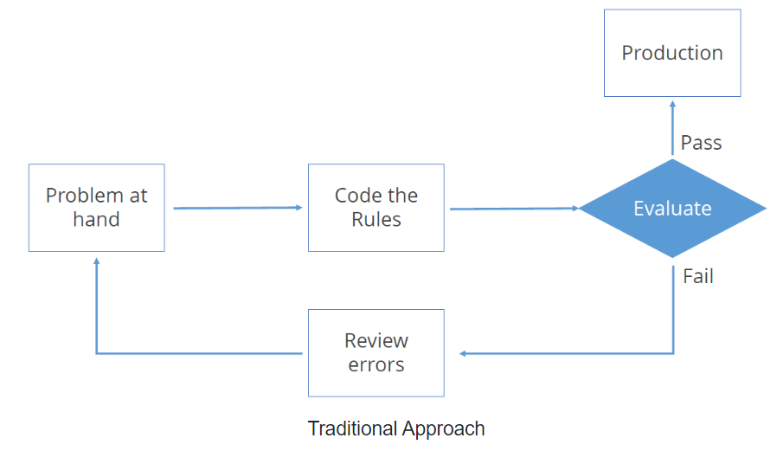
Traditional programming overview
traditional programming relies on hard-coded rules

Slide 6
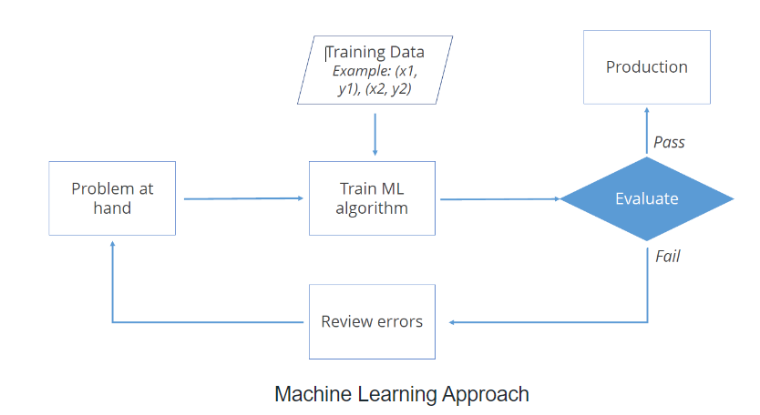
Machine learning overview
Machine learning relies on learning pattern from sample data

Slide 7
Machine Learning (ML)
Machine Learning (ML) is an automated learning with little or no human intervention. It involves programming computers so that they learn from the available inputs. The main purpose of machine learning is to explore and construct algorithms that can learn from the previous data and make predictions on new input data.

Slide 8
So what the machine learning is…
Automating automation
Getting computers to program themselves
Let the data do the work instead!

Slide 9
Growth of Machine Learning
Machine learning is the preferred approach to
Speech recognition, Natural language processing
Computer vision
Medical outcomes analysis
Robot control
Computational biology

Slide 10
Growth of Machine Learning
This trend is accelerating
Improved machine learning algorithms
Improved data capture, networking, faster computers
Software too complex to write by hand
New sensors / IOT devices
Demand for self-customization to user, environment

Slide 11
Applications of Machine Learning Algorithms Activity
Notes:
Web search
Computational biology
Finance
E-commerce
Space exploration
Robotics
Information extraction
Social networks
Debugging
Data mining
Expert systems
Robotics
Vision processing
Language processing
Forecasting things like stock market trends, weather
Pattern recognition
Games
[Your favorite area]

Slide 12
Benefits of Machine Learning
Powerful Processing
Better Decision Making & Prediction
Quicker Processing
Accurate
Affordable Data Management
Inexpensive
Analyzing Complex Big Data

Slide 13
Steps Involved in Machine Learning
A machine learning project involves the following steps:
Defining a Problem
Preparing Data
Evaluating Algorithms
Improving Results
Presenting Results

Slide 14
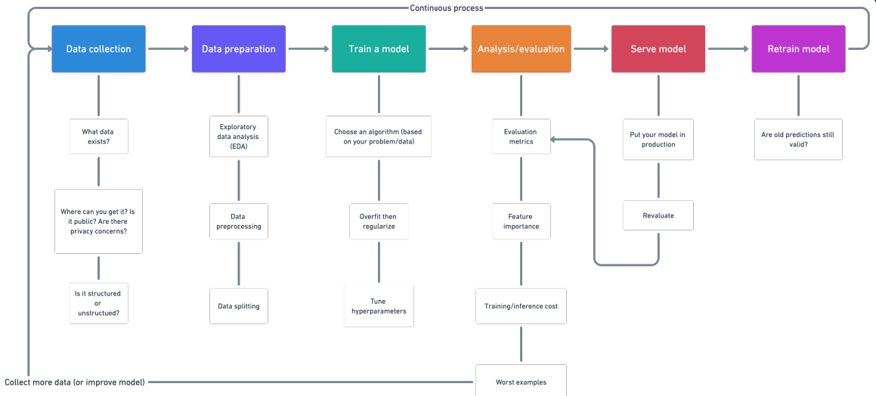
Raw data
Test/Train dataset with quantized
features
Evaluated
Model with high accuracy/
recall/
f-measure
Monitored logs analysis
model

Slide 15
Data Collection

Slide 16
Data Collection
Data collection: the process of collecting raw data
Data feeds
Logs
Execution trace
Human observation
Statistical data
….

Slide 17
Data Preparation

Slide 18
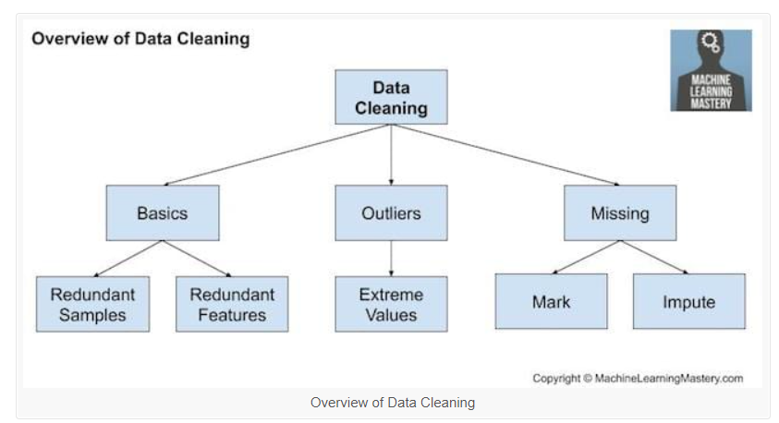
Data Preparation/Cleaning

Slide 19
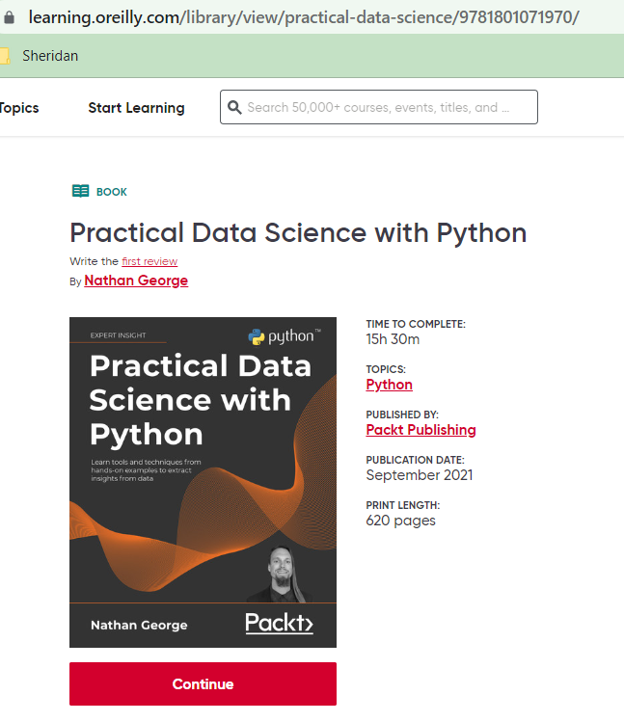

Resources for data preparation/ cleaning

Slide 20
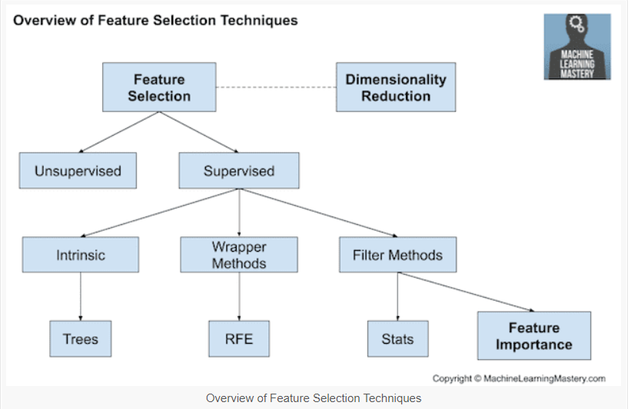
Data preparation: Feature selection
Feature selection: is the process of selecting a subset of relevant features (variables, predictors) for use in model construction.
Every model constructed with some features

Slide 21
Training model

Slide 22
Train a model
List of some algorithms for model learning:
Linear Regression
Logistic Regression
Decision Tree
SVM
Naive Bayes
kNN
K-Means
Random Forest

Slide 23
Evaluation
Accuracy
Precision and recall
Squared error
Likelihood
Posterior probability
Cost / Utility
Margin
Entropy
K-L divergence
Etc.

Slide 24
Types of Learning
Supervised (inductive) learning
Training data includes desired outputs
Unsupervised learning
Training data does not include desired outputs
Semi-supervised learning
Training data includes a few desired outputs
Reinforcement learning
Rewards from a sequence of actions

Slide 25
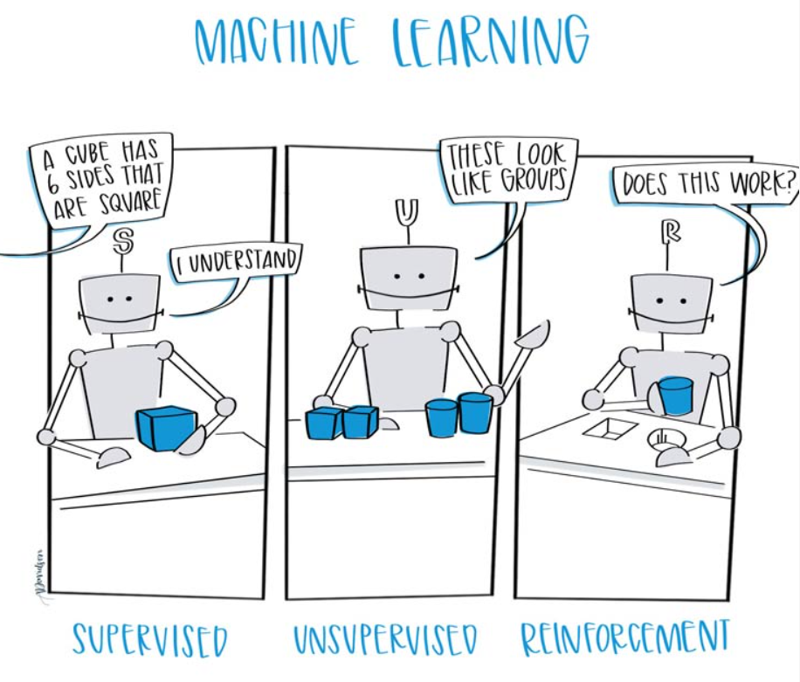
https://www.ceralytics.com/3-types-of-machine-learning/

Slide 26
Supervised Learning
The majority of practical machine learning uses supervised learning.
In supervised learning, the system tries to learn from the previous examples that are given. (On the other hand, in unsupervised learning, the system attempts to find the patterns directly from the example given.)
Speaking mathematically, supervised learning is where you have both input variables (x) and output variables(Y) and can use an algorithm to derive the mapping function from the input to the output.
The mapping function is expressed as Y = f(X).

Slide 27
Supervised Learning
When an algorithm learns from example data and associated target responses that can consist of numeric values or string labels, such as classes or tags, in order to later predict the correct response when posed with new examples comes under the category of Supervised learning.
This approach is indeed similar to human learning under the supervision of a teacher. The teacher provides good examples for the student to memorize, and the student then derives general rules from these specific examples.

Slide 28
Supervised Learning: Uses
Prediction of future cases: Use the rule to predict the output for future inputs
Knowledge extraction: The rule is easy to understand
Compression: The rule is simpler than the data it explains
Outlier detection: Exceptions that are not covered by the rule, e.g., fraud

Slide 29
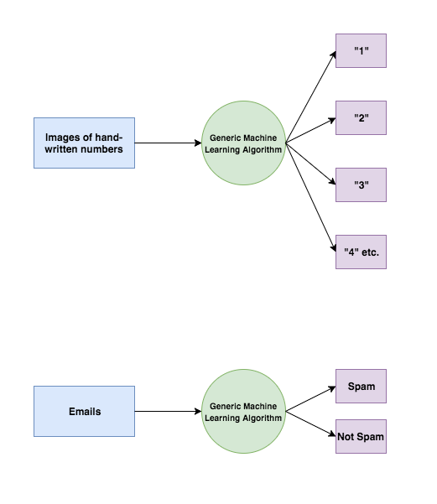
Supervised Learning

Slide 30
Categories of Supervised learning
Supervised learning problems can be further divided into two parts, namely classification, and regression.
Classification: A classification problem is when the output variable is a category or a group, such as “black” or “white” or “spam” and “no spam”.
Regression: A regression problem is when the output variable is a real value, such as “price” or “height.”

Slide 31
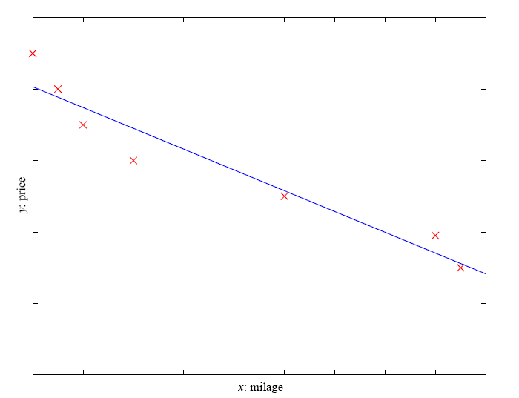
Prediction: Regression
Example: Price of a used car
x : car attributes
y : price
y = g (x | θ )
g ( ) model,
θ parameters
y = wx+w₀

Slide 32
Unsupervised Learning
In unsupervised learning, the algorithms are left to themselves to discover interesting structures in the data.
Mathematically, unsupervised learning is when you only have input data (X) and no corresponding output variables.
This is called unsupervised learning because unlike supervised learning above, there are no given correct answers and the machine itself finds the answers.

Slide 33
Unsupervised Learning
Learning “what normally happens”
No output
Clustering: Grouping similar instances
Other applications: Summarization, Association Analysis
Example applications
Customer segmentation
Image compression: Colour quantization
Bioinformatics: Learning motifs

Slide 34
Categories of Unsupervised learning
Unsupervised learning problems can be further divided into association and clustering problems.
Association: An association rule learning problem is where you want to discover rules that describe large portions of your data, such as “people that buy X also tend to buy Y”.
Clustering: A clustering problem is where you want to discover the inherent groupings in the data, such as grouping customers by purchasing behavior.

Slide 35
Learning Associations
Basket analysis:
P (Y | X ) probability that somebody who buys X also buys Y where X and Y are products/services.
Example: P ( chips | beer ) = 0.7
Market-Basket transactions

Slide 36
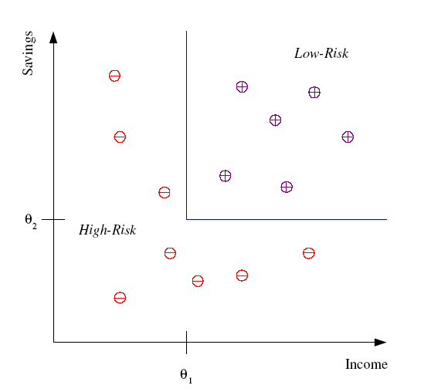
Classification
Example: Credit scoring
Differentiating between low-risk and high-risk customers from their income and savings
Discriminant: IF income > θ₁ AND savings > θ₂
THEN low-risk ELSE high-risk
Model

Slide 37
Classification: Applications
Pattern recognition
Face recognition: Pose, lighting, occlusion (glasses, beard), make-up, hair style
Character recognition: Different handwriting styles.
Speech recognition: Temporal dependency.
Use of a dictionary or the syntax of the language.
Sensor fusion: Combine multiple modalities; eg, visual (lip image) and acoustic for speech
Medical diagnosis: From symptoms to illnesses
Web Advertising: Predict if a user clicks on an ad on the Internet.

Slide 38








Face Recognition
Training examples of a person
Test images
AT&T Laboratories, Cambridge UK
http://www.uk.research.att.com/facedatabase.html

Slide 39
Reinforcement Learning
Topics:
Policies: what actions should an agent take in a particular situation
Utility estimation: how good is a state (→used by policy)
No supervised output but delayed reward
Applications:
Game playing
Robot in a maze
Multiple agents, partial observability, ...

Slide 40
Reinforcement Learning
A computer program will interact with a dynamic environment in which it must perform a particular goal (such as playing a game with an opponent or driving a car). The program is provided feedback in terms of rewards and punishments as it navigates its problem space.
Using this algorithm, the machine is trained to make specific decisions. It works this way: the machine is exposed to an environment where it continuously trains itself using trial and error method.
Here learning data gives feedback so that the system adjusts to dynamic conditions in order to achieve a certain objective. The system evaluates its performance based on the feedback responses and reacts accordingly. The best-known instances include self-driving cars and the chess master algorithm AlphaGo.

Slide 41
Semi-supervised learning
If some learning samples are labelled, but some others are not labelled, then it is semi-supervised learning. It makes use of a large amount of unlabeled data for training and a small amount of labelled data for testing. Semi-supervised learning is applied in cases where it is expensive to acquire a fully labelled dataset while more practical to label a small subset.

Slide 42
Why Machine Learning with Python
Python is popular for research and development of production systems. It is a vast language with number of modules, packages and libraries that provides multiple ways of achieving a task.
Python and its libraries like NumPy, Pandas, SciPy, Scikit-Learn, Matplotlib are used in data science and data analysis. They are also extensively used for creating scalable machine learning algorithms.
Python implements popular machine-learning techniques such as Classification, Regression, Recommendation, and Clustering.
Python offers ready-made framework for performing data mining tasks on large volumes of data effectively in lesser time

Slide 43
Libraries and Packages
To understand machine learning, you need to have basic knowledge of Python programming. In addition, there are a number of libraries and packages generally used in performing various machine learning tasks as listed below:
numpy - is used for its N-dimensional array objects
pandas – is a data analysis library that includes dataframes
matplotlib – is 2D plotting library for creating graphs and plots
scikit-learn - the algorithms used for data analysis and data mining tasks
seaborn – a data visualization library based on matplotlib

Slide 44
Reference for Machine Learning

Slide 45
Supervised Learning

Slide 46
Supervised Learning: review
Data is labeled, which means every data is belong to a class
Supervised learning problems
classification, and
Regression
List of Common Algorithms
Nearest Neighbour
Naive Bayes
Decision Trees
Linear Regression
Support Vector Machines (SVM)
Neural Networks

Slide 47
Support Vector Machines

Slide 48
Intuitions
O
X
O
X
O
X
X
O
O
X
O
X
X
O
O
X

Slide 49
Intuitions
O
X
O
X
O
X
X
O
O
X
O
X
X
O
O
X

Slide 50
Intuitions
O
X
O
X
O
X
X
O
O
X
O
X
X
O
O
X

Slide 51
Intuitions
O
X
O
X
O
X
X
O
O
X
O
X
X
O
O
X

Slide 52
A “Good” Separator
O
X
O
X
O
X
X
O
O
X
O
X
X
O
O
X

Slide 53
Noise in the Observations
O
X
O
X
O
X
X
O
O
X
O
X
X
O
O
X

Slide 54
Ruling Out Some Separators
O
X
O
X
O
X
X
O
O
X
O
X
X
O
O
X

Slide 55
Maximizing the Margin
O
X
O
X
O
X
X
O
O
X
O
X
X
O
O
X

Slide 56
“Fat” Separators
X
O
X
O
X
X
O
O
X
O
X
X
O
O
X

Slide 57
Support Vectors
O
X
O
X
O
X
X
O
O
X
O
X
X
O
O
X

Slide 58
The Math
Training instances
x ∈ ℜ^{n}
y ∈ {-1, 1}
Decision function
f(x) = sign(<w,x> + b)
w ∈ ℜ^{n}
b ∈ ℜ
Find w and b that
Perfectly classify training instances
Assuming linear separability
Maximize margin

Slide 59
The Math
For perfect classification, we want
y_{i} (<w,x_{i}> + b) ≥ 0 for all i
Why?
To maximize the margin, we want
w that minimizes |w|²

Slide 60
Strengths of SVMs
Good generalization in theory
Good generalization in practice
Work well with few training instances
Find globally best model
Efficient algorithms
Amenable to the kernel trick

